Slide 1
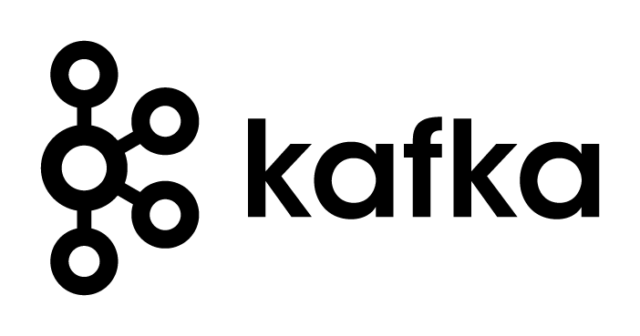
Apache Kafka
aakash
mohit

Slide 2
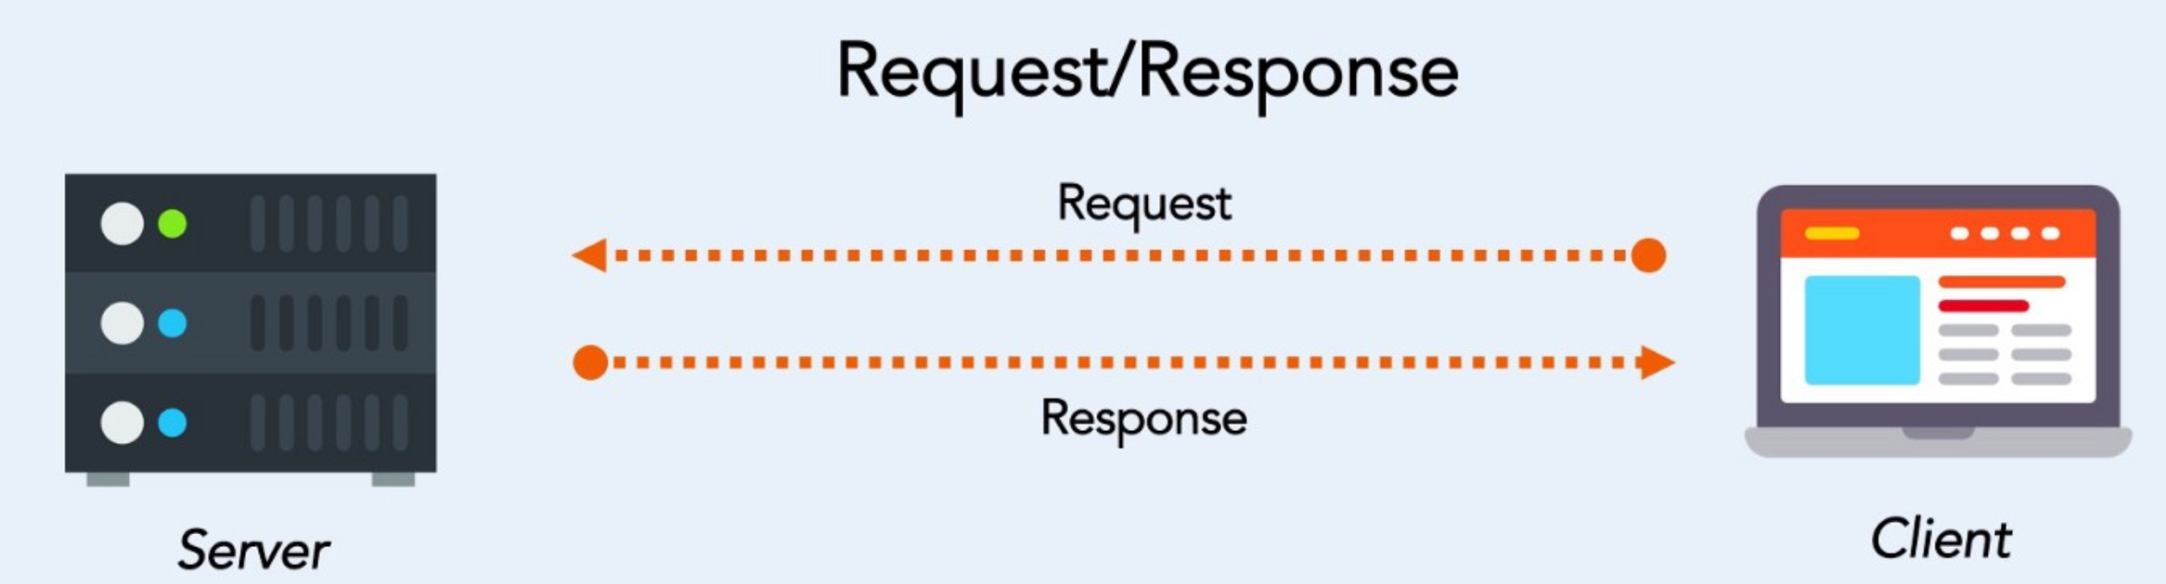
Request Driven Messaging (HTTP)
Typically synchronous
Point to point
High latency (compared to data streaming)
Pre-defined API

Slide 3
Asynchronous Messaging
In asynchronous messaging, the sender does not need to know anything about the receiver; the receiver does not need to know anything about the sender. Instead, the sender and the receiver need to know only which message format and which destination to use. The non-blocking nature of this communication allows recipients to only consume resources while active, which ultimately leads to less system overhead.

Slide 4
What tools are available to help achieve this?
There are many tools available to help you set up an asynchronous message-driven backbone for your reactive applications. The two main variations are Kafka and IBM MQ(Messaging Queue).

Slide 5
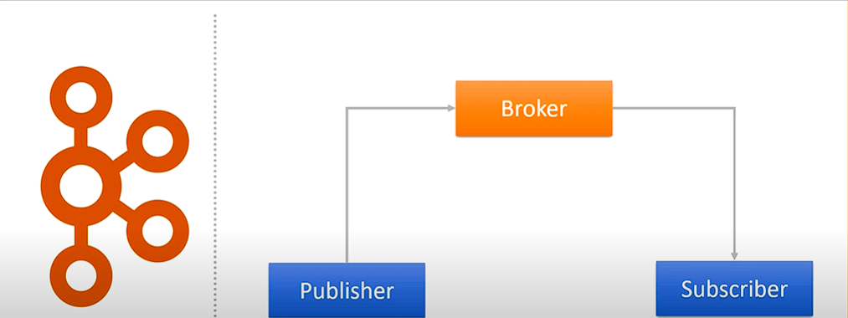
Apache Kafka
Apache Kafka is a distributed publish-subscribe messaging system that can handle a high volume of data and is designed to be fault-tolerant, scalable, high-throughput, and low-latency.

Slide 6
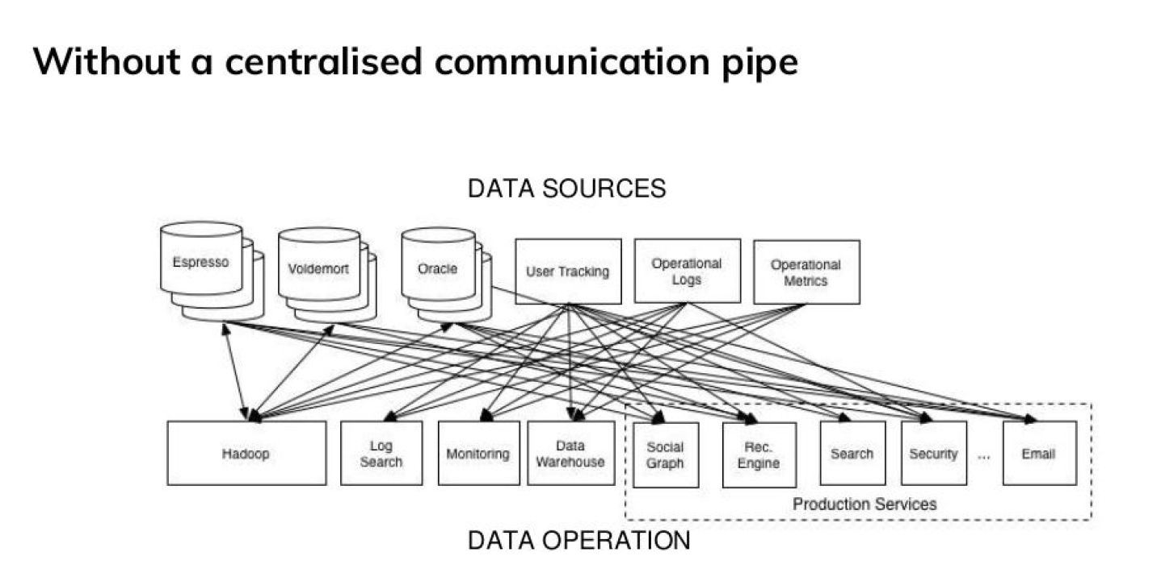
Why Kafka?

Slide 7
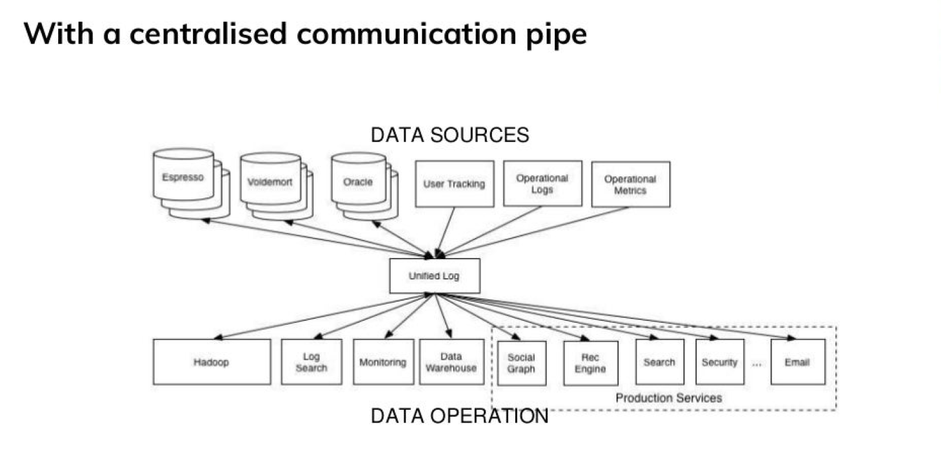
Why Kafka?

Slide 8
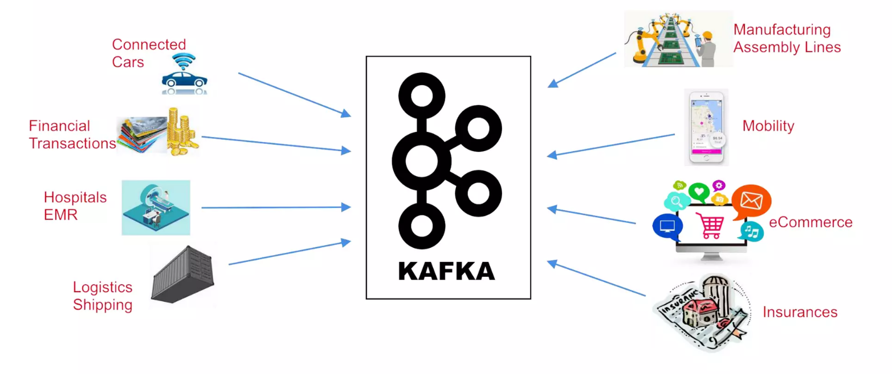
The World Produces Data

Slide 9
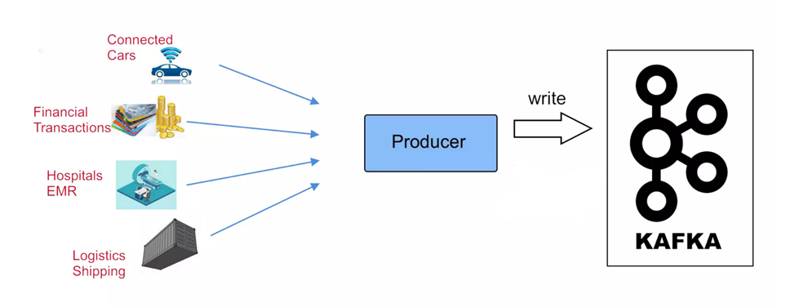
Producers

Slide 10
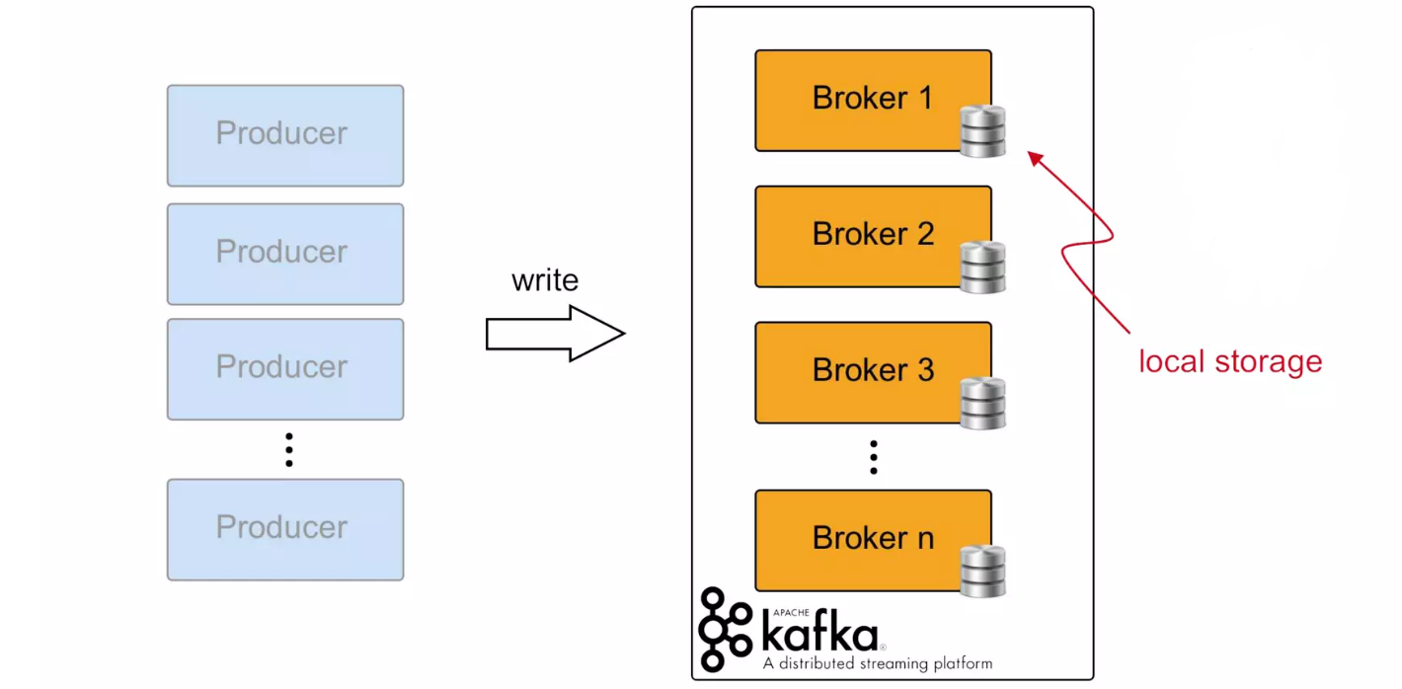
Kafka Brokers

Slide 11
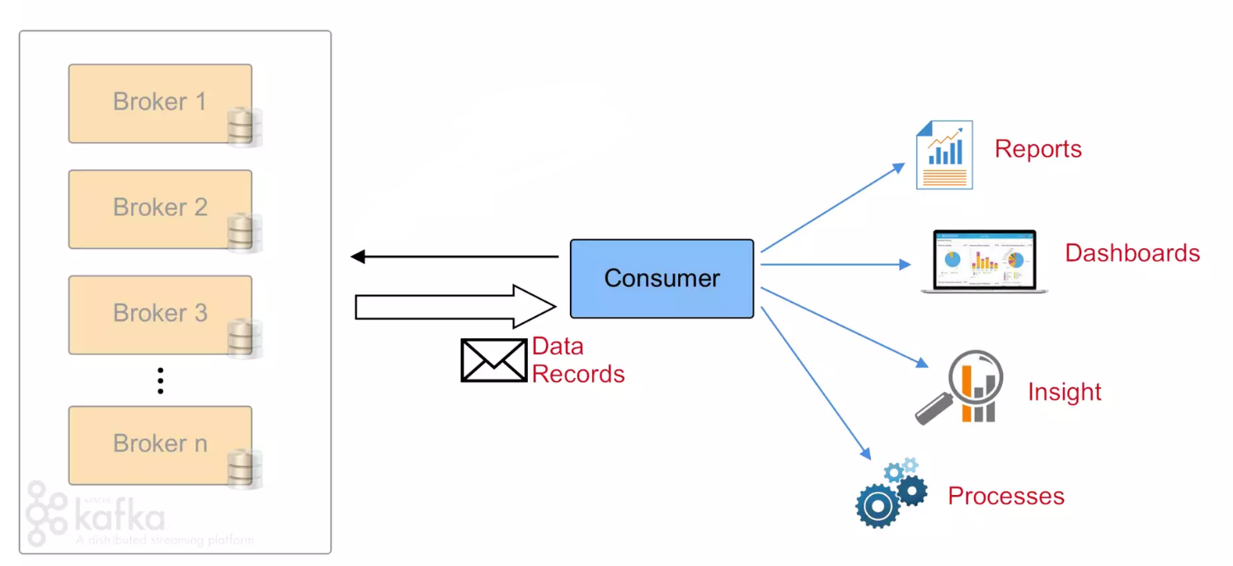
Consumers

Slide 12
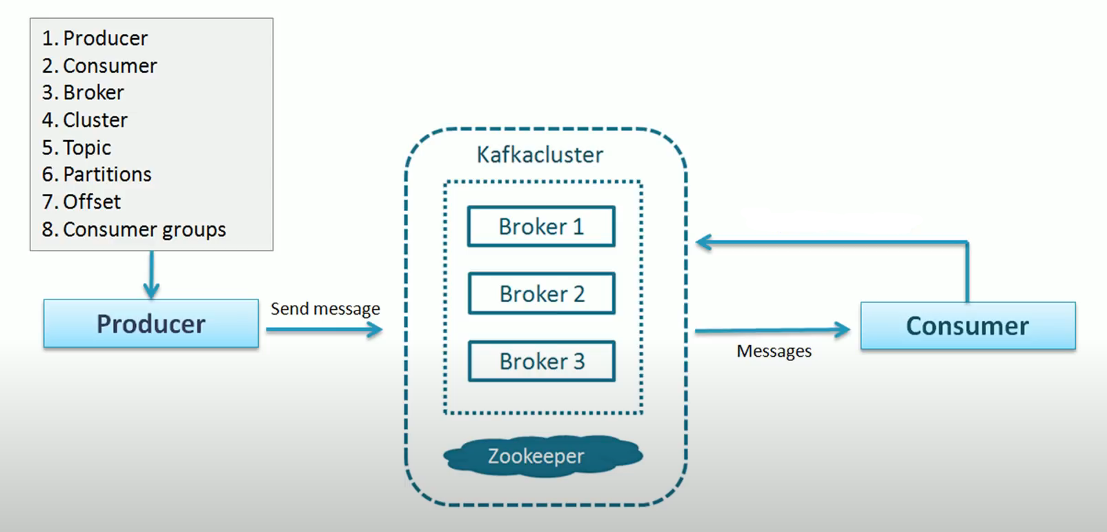
Kafka Architecture

Slide 13
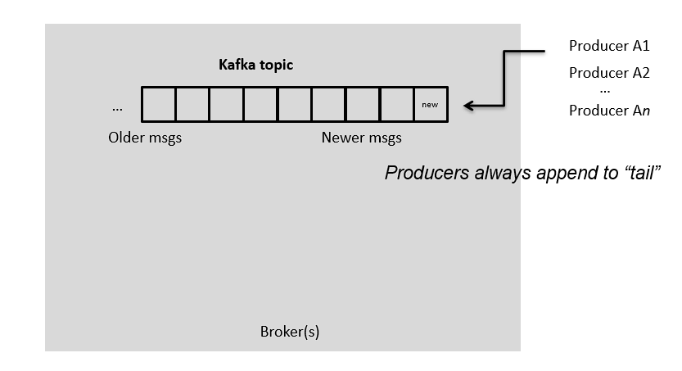
Topics

Slide 14
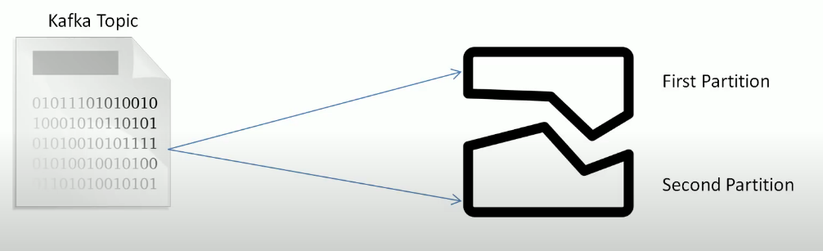
Partitions

Slide 15
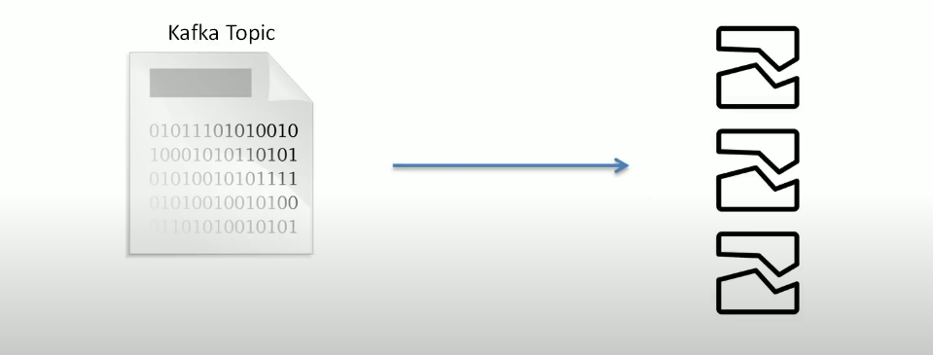
How many Partitions?

Slide 16
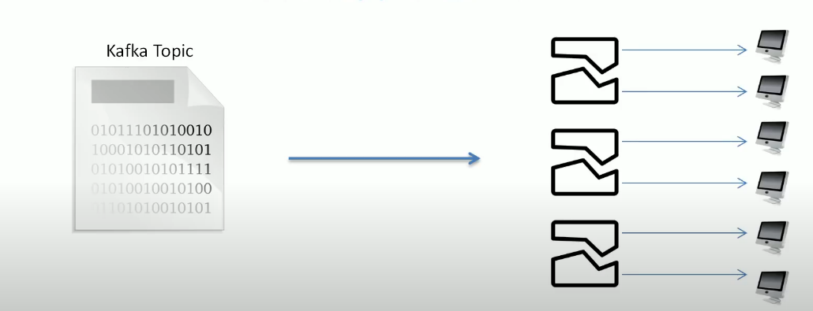
How many Partitions?

Slide 17
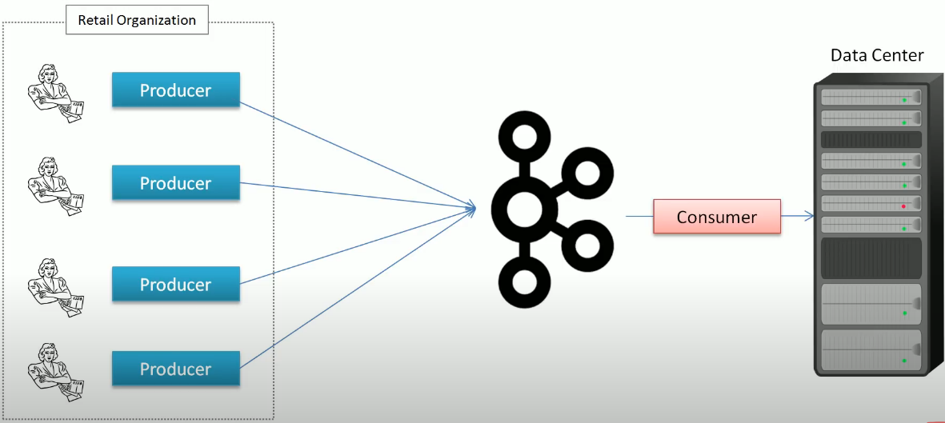
Consumer Group

Slide 18
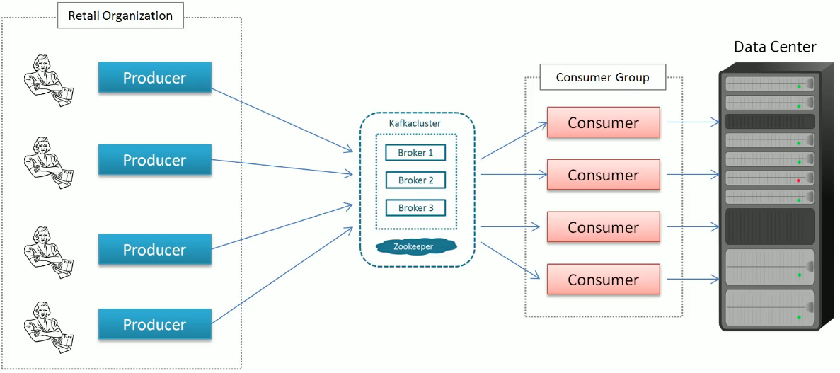
Consumer Group

Slide 19
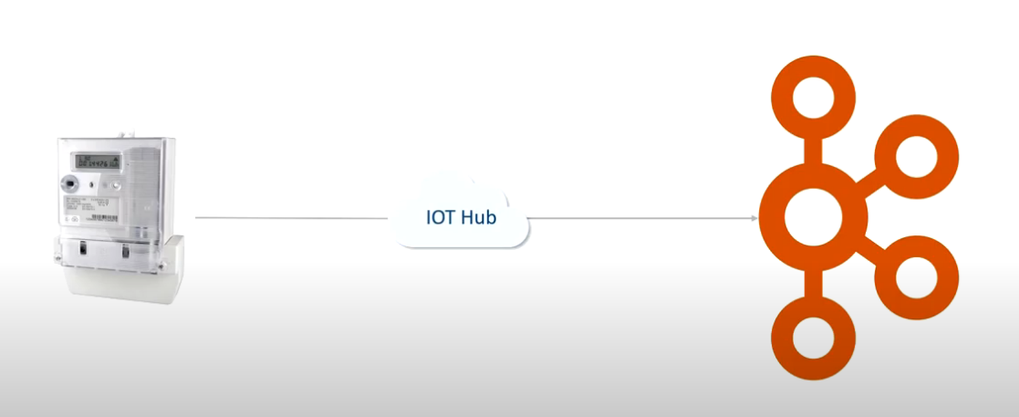
Kafka Streaming

Slide 20
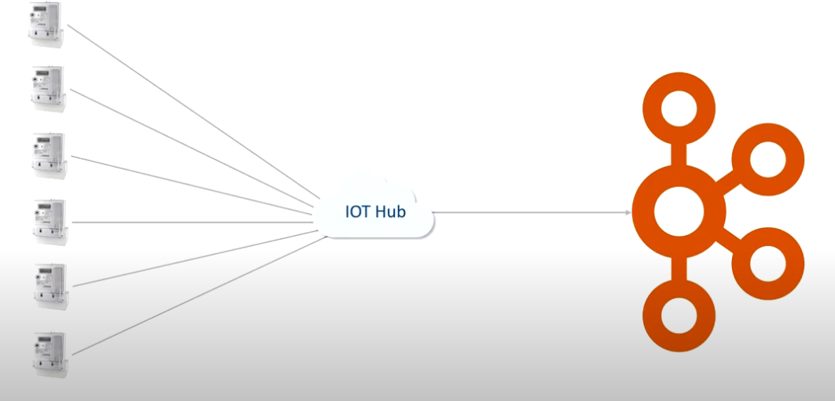
Kafka Streaming

Slide 21
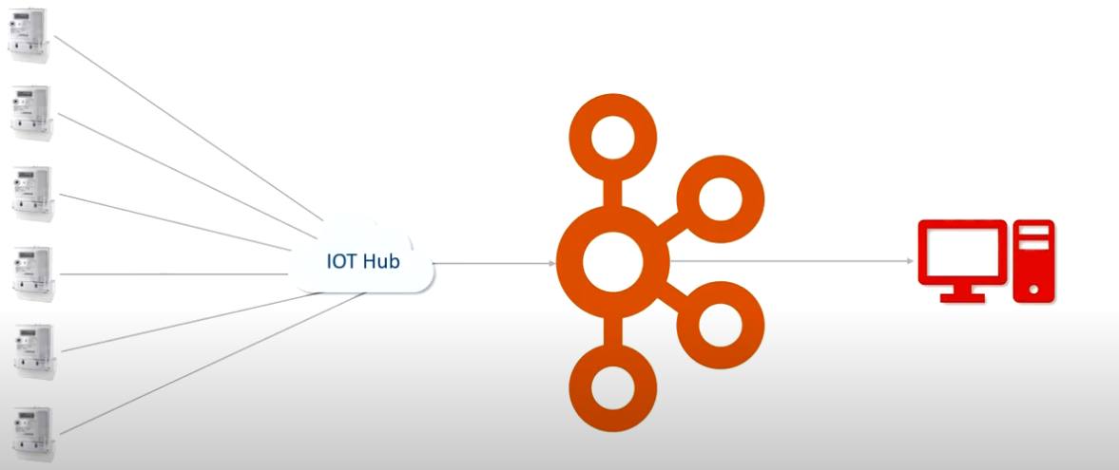
Kafka Streaming

Slide 22
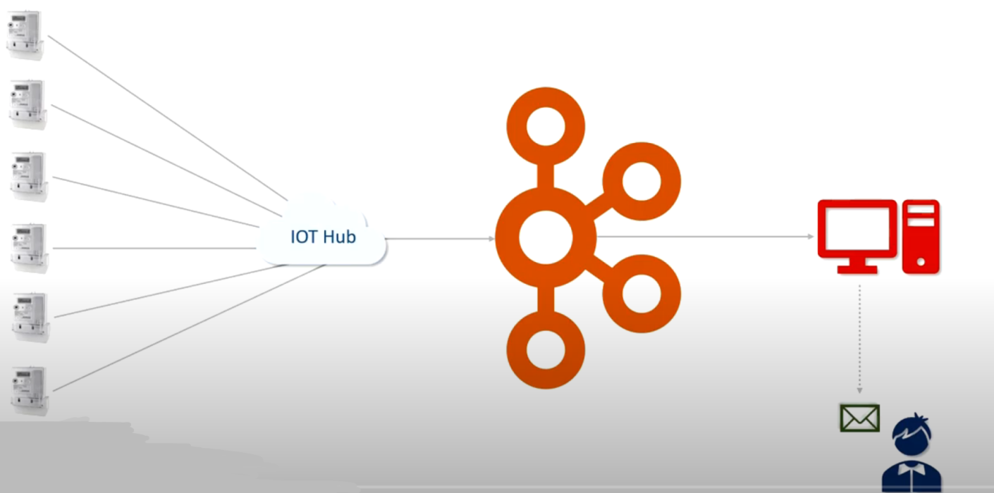
Kafka Streaming

Slide 23
Kafka Advantages
Low Latency
High Throughput
Fault Tolerance
Scalability
Open Source

Slide 24
Companies that use Kafka
More than 80% of all Fortune 100 companies trust, and use Kafka.
Uber – Gather a user, taxi, and trip data in real-time to compute and forecast demand and compute surge pricing in real-time
LinkedIn – Prevents spam and collects user interactions to make better connection recommendations in real-time
Twitter
Spotify
Airbnb, and many more.

Slide 25
Kafka QuickStart
Download Kafka, creating a console-based consumer/producer.
Requires ZooKeeper to be installed and running.
Create a topic as required by the project.
Create a project with the required dependencies.

